Slide 1
CHAPTER 4 MEMORY HIERARCHIES
MEMORY HIERARCHIES
CACHE DESIGN
TECHNIQUES TO IMPROVE CACHE PERFORMANCE
VIRTUAL MEMORY SUPPORT

Slide 2
TYPICAL MEMORY HIERARCHY
PRINCIPLE OF LOCALITY:
A PROGRAM ACCESSES A RELATIVELY SMALL PORTION OF THE ADDRESS SPACE AT A TIME
TWO DIFFERENT TYPES OF LOCALITY:
TEMPORAL LOCALITY: IF AN ITEM IS REFERENCED, IT WILL TEND TO BE REFERENCED AGAIN SOON
SPATIAL LOCALITY: IF AN ITEM IS REFERENCED, ITEMS WHOSE ADDRESSES ARE CLOSE TEND TO BE REFERENCED SOON
SPATIAL LOCALITY TURNS INTO TEMPORAL LOCALITY IN BLOCKS/PAGES

Slide 3
TYPICAL MEMORY HIERARCHY: THE PYRAMID

Slide 4
CACHE PERFORMANCE
AVERAGE MEMORY ACCESS TIME (AMAT)
AMAT= hit time + miss rate x miss penalty
MISS RATE: FRACTION OF ACCESSES NOT SATISFIED AT THE HIGHEST LEVEL
NUMBER OF MISSES IN L1 DIVIDED BY THE NUMBER OF PROCESSOR REFERENCES
ALSO HIT RATE = 1 - MISS RATE
MISSES PER INSTRUCTIONS (MPI)
NUMBER OF MISSES IN L1 DIVIDED BY NUMBER OF INSTRUCTIONS
EASIER TO USE THAN MISS RATE: CPI = CPI₀ + MPI*MISS PENALTY
MISS PENALTY: AVERAGE DELAY PER MISS CAUSED IN THE PROCESSOR
IF PROCESSOR BLOCKS ON MISSES, THEN THIS IS SIMPLY THE NUMBER OF CLOCK CYCLES TO BRING A BLOCK FROM MEMORY OR MISS LATENCY
IN A OoO PROCESSOR, THE PENALTY OF A MISS CANNOT BE MEASURED DIRECTLY
DIFFERENT FROM MISS LATENCY
MISS RATE AND PENALTY CAN BE DEFINED AT EVERY CACHE LEVELS
USUALLY NORMALIZED TO THE NUMBER OF PROCESSOR REFERENCES
OR TO THE NUMBER OF ACCESSES FROM THE LOWER LEVEL

Slide 5
CACHE MAPPING
MEMORY BLOCKS ARE MAPPED TO CACHE LINES
MAPPING CAN BE DIRECT, SET-ASSOCIATIVE OR FULLY ASSOCIATIVE
DIRECT-MAPPED: EACH MEMORY BLOCK CAN BE MAPPED TO ONLY ONE CACHE LINE: BLOCK ADDRESS MODULO THE NUMBER OF LINES IN CACHE
SET-ASSOCIATIVE: EACH MEMORY BLOCK CAN BE MAPPED TO A SET OF LINES IN CACHE; SET NUMBER IS BLOCK ADDRESS MODULO THE NUMBER OF CACHE SETS
FULLY ASSOCIATIVE: EACH MEMORY BLOCK CAN BE IN ANY CACHE LINE
CACHE IS MADE OF DIRECTORY+ DATA MEMORY, ONE ENTRY PER CACHE LINE
DIRECTORY: STATUS (STATE) BITS: VALID, DIRTY, REFERENCE, CACHE COHERENCE
CACHE ACCESS HAS TWO PHASES
USE INDEX BITS TO FETCH THE TAGS AND DATA FROM THE SET (CACHE INDEX)
CHECK TAGS TO DETECT HIT/MISS

Slide 6
CACHE ACCESS
TWO PHASES: INDEX + TAG CHECK
DIRECT-MAPPED CACHES: CACHE SLICE
EXAMPLE OF A DIRECT-MAPPED CAHE WITH TWO WORDS PER LINE.

Slide 7
CACHE ACCESS
SET-ASSOCIATIVE CACHE
FULLY ASSOCIATIVE

Slide 8
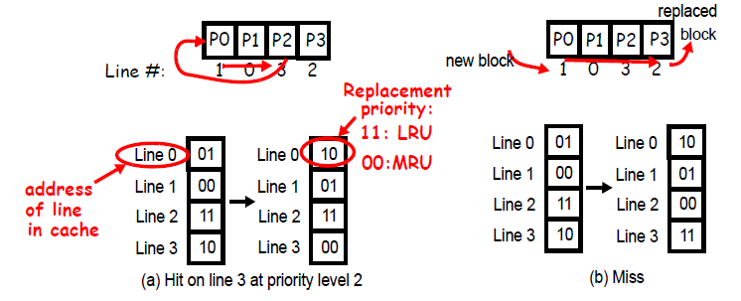
REPLACEMENT POLICIES
RANDOM, LRU, FIFO, PSEUDO-LRU
MAINTAINS REPLACEMENT BITS
EXAMPLE: LEAST-RECENTLY USED (LRU)
DIRECT-MAPPED: NO NEED
SET-ASSOCIATIVE: PER-SET REPLACEMENT
FULLY ASSOCIATIVE: CACHE REPLACEMENT

Slide 9
WRITE POLICIES
WRITE THROUGH: WRITE TO NEXT LEVEL ON ALL WRITES
COMBINED WITH WRITE BUFFER TO AVOID CPU STALLS
SIMPLE, NO INCONSISTENCY AMONG LEVELS
WRITE-BACK: WRITE TO NEXT LEVEL ON REPLACEMENT
WITH THE HELP OF A DIRTY BIT AND A WRITE-BACK BUFFER
WRITES HAPPEN ON A MISS ONLY
ALLOCATION ON WRITE MISSES
ALWAYS ALLOCATE IN WRITE-BACK; DESIGN CHOICE IN WRITE-THROUGH

Slide 10
CLASSIFICATION OF CACHE MISSES
THE 3 C’s
COMPULSORY (COLD) MISSES: ON THE 1ST REFERENCE TO A BLOCK
CAPACITY MISSES: SPACE IS NOT SUFFICIENT TO HOST DATA OR CODE
CONFLICT MISSES: HAPPEN WHEN TWO MEMORY BLOCKS MAP ON THE SAME CACHE BLOCK IN DIRECT-MAPPED OR SET-ASSOCIATIVE CACHES
LATER ON: COHERENCE MISSES ➔ 4C’s CLASSIFICATION
HOW TO FIND OUT?
COLD MISSES: SIMULATE INFINITE CACHE SIZE
CAPACITY MISSES: SIMULATE FULLY ASSOCIATIVE CACHE THEN DEDUCT COLD MISSES
CONFLICT MISSES: SIMULATE CACHE THEN DEDUCT COLD AND CAPACITY MISSES
CLASSIFICATION IS USEFUL TO UNDERSTAND HOW TO ELIMINATE MISSES
PROBLEM: WHICH REPLACEMENT POLICY SHOULD WE USE IN THE FULLY ASSOCIATIVE CACHE?

Slide 11
MULTI-LEVEL CACHE HIERARCHIES
1ST-LEVEL AND 2ND LEVEL ARE ON-CHIP;3RD AND 4TH LEVELS ARE MOSTLY OFF-CHIP
USUALLY, CACHE INCLUSION IS MAINTAINED
WHEN A BLOCK MISSES IN L1 THEN IT MUST BE BROUGHT INTO ALL Li.
WHEN A BLOCK IS REPLACED IN Li, THEN IT MUST BE REMOVED FROM ALL Lj, j<i
ALSO: EXCLUSION
IF A BLOCK IS IN Li THEN IT IS NOT IN ANY OTHER CACHE LEVEL
IF A BLOCK MISSES IN L1 THEN ALL COPIES ARE REMOVED FROM ALL Li’s, i>1
IF A BLOCK IS REPLACED IN Li THEN IT IS ALLOCATED IN Li+1
OR NO POLICY
WE WILL ASSUME INCLUSION

Slide 12
EFFECT OF CACHE PARAMETERS
LARGER CACHES
SLOWER,
MORE COMPLEX,
LESS CAPACITY MISSES
LARGER BLOCK SIZE
EXPLOIT SPATIAL LOCALITY
TOO BIG A BLOCK INCREASES CAPACITY MISSES
BIG BLOCKS ALSO INCREASE MISS PENALTY
HIGHER ASSOCIATIVITY
ADDRESSES CONFLICT MISSES
8-16 WAY SA IS AS GOOD AS FULLY ASSOCIATIVE
A 2-WAY SA CACHE OF SIZE N HAS A SIMILAR MISS RATE AS A DIRECT MAPPED CACHE OF SIZE 2N
HIGHER HIT TIME

Slide 13
LOCKUP-FREE (NON-BLOCKING CACHES)
CACHE IS A 2-PORTED DEVICE: MEMORY & PROCESSOR
IF A LOCKUP-FREE CACHE MISSES, IT DOES NOT BLOCK
RATHER, IT HANDLES THE MISS AND KEEPS ACCEPTING ACCESSES FROM THE PROCESSOR
ALLOWS FOR THE CONCURRENT PROCESSING OF MULTIPLE MISSES AND HITS
CACHE HAS TO BOOKKEEP ALL PENDING MISSES
MSHRs (Miss Status Handling Registers) CONTAIN THE ADDRESS OF PENDING MISS, THE DESTINATION BLOCK IN CACHE, AND THE DESTINATION REGISTER
NUMBER OF MSHRs LIMITS THE NUMBER OF PENDING MISSES
DATA DEPENDENCIES EVENTUALLY BLOCK THE PROCESSOR
NON-BLOCKING CACHES ARE REQUIRED IN DYNAMICALLY SCHEDULED PROCESSOR AND TO SUPPORT PREFETCHING

Slide 14
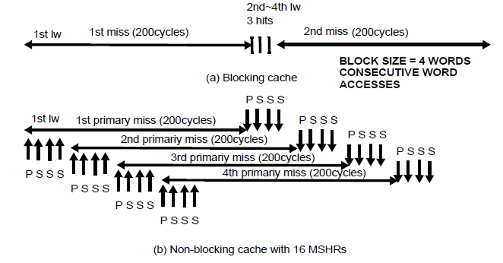
LOCKUP-FREE CACHES:PRIMARY/SECONDARY MISSES
PRIMARY: THE FIRST MISS TO A BLOCK
SECONDARY: FOLLOWING ACCESSES TO BLOCKS PENDING DUE TO PRIMARY MISS
LOT MORE MISSES (BLOCKING CACHE ONLY HAS PRIMARY MISSES)
NEEDS MSHRs FOR BOTH PRIMARY AND SECONDARY MISSES
MISSES ARE OVERLAPPED WITH COMPUTATION AND OTHER MISSES

Slide 15
HARDWARE PREFETCHING OF INSTRUCTIONS AND DATA
SEQUENTIAL PREFETCHING OF INSTRUCTIONS
ON AN I-FETCH MISS, FETCH TWO BLOCKS INSTEAD OF ONE
SECOND BLOCK IS STORED IN AN I-STREAM BUFFER
IF I-STREAM-BUFFER HITS, BLOCK IS MOVED TO L1
I-STREAM BUFFER BLOCKS ARE OVERLAID IF NOT ACCESSED
ALSO APPLICABLE TO DATA, BUT LESS EFFECTIVE
HARDWARE PREFETCH ENGINES
DETECT STRIDES IN STREAM OF MISSING ADDRESSES, THEN START FETCHING AHEAD

Slide 16
COMPILER-CONTROLLED (aka SOFTWARE) PREFETCHING
INSERT PREFETCH INSTRUCTIONS IN CODE
THESE ARE NON-BINDING, LOAD IN CACHE ONLY
IN A LOOP, WE MAY INSERT PREFETCH INSTRUCTIONS IN THE BODY OF THE LOOP TO PREFETCH DATA NEEDED IN FUTURE LOOP ITERATIONS.
LOOP L.D F2,0(R1)
PREF -24(R1)
ADD.D F4,F2,F0
S.D F4,O(R1)
SUBI R1,R1,#8
BNEZ R1, LOOP
CAN WORK FOR BOTH LOADS AND STORES
REQUIRES A NON-BLOCKING CACHE
INSTRUCTION OVERHEAD
DATA MUST BE PREFETCHED ON TIME, SO THAT THEY ARE PRESENT IN CACHE AT THE TIME OF ACCESS
DATA MAY NOT BE PREFETCHED TOO EARLY SO THAT THEY ARE STILL IN CACHE AT THE TIME OF THE ACCESS
CAN EASILY BE DONE FOR ARRAYS, BUT CAN BE APPLIED TO POINTER ACCESSES

Slide 17
FASTER HIT TIMES
PRINCETON vs HARVARD CACHE:
PRINCETON: UNIFIED INSTRUCTIONS/DATA CACHE
HARVARD: SPLIT INSTRUCTION AND DATA CACHE
PRINCETON MEANS THAT INSTRUCTIONS AND DATA CAN USE THE WHOLE CACHE, AS THEY NEED
HARVARD MEANS THAT BOTH CACHES CAN BE OPTIMIZED FOR THEIR ACCESS TYPE
IN A PIPELINED MACHINE, FLC IS HARVARD AND SLC IS PRINCETON
PIPELINE CACHE ACCESSES
ESPECIALLY USEFUL FOR STOREs
PIPELINE TAG CHECK AND DATA STORE
SEPARATE READ AND WRITE PORTS TO CACHE OPTIMIZED FOR EACH
ALSO USEFUL FOR I-CACHES AND LW IN D-CACHES
INCREASES THE PIPELINE LENGTH
MUST FIND WAYS OF SPLITTING CACHE ACCESSES INTO STAGES

Slide 18
FASTER HIT TIMES
KEEP THE CACHE SIMPLE AND FAST
THIS FAVORS DIRECT-MAPPED CACHES
LESS MULTIPLEXING
OVERLAP OF TAG CHECK AND USE OF DATA
INTERESTINGLY, THE SIZE OF FLC TENDS TO DECREASE AND ASSOCIATIVITY GOES UP AS FLCs TRY TO KEEP UP WITH CPU
AVOID ADDRESS TRANSLATION OVERHEAD (ToBeCoveredLater)
Processor | L1 data cache
Alpha 21164 | 8KB, direct mapped
Alpha 21364 | 64KB, 2-way
MPC750 | 32KB, 8-way, PLRU
PA-8500 | 1MB, 4-way, PLRU
Classic Pentium | 16K, 4-way, LRU
Pentium-II | 16KB, 4 -way, PLRU
Pentium-III | 16K, 4-way, PLRU
Pentium-IV | 8KB, 4-way, PLRU
Mips R10K/12K | 32KB, 2-way, LRU
UltraSPARC-IIi | 16KB, direct mapped
UltraSPARC-III | 64KB, 4-way, Random

Slide 19
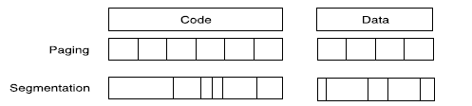
VIRTUAL MEMORY—WHY?
ALLOWS APPLICATIONS TO BE BIGGER THAN MAIN MEMORY SIZE
PREVIOUSLY: MEMORY OVERLAYS
HELPS WITH MULTIPLE PROCESS MANAGEMENT
EACH PROCESS GETS ITS OWN CHUNK OF MEMORY
PROTECTION OF PROCESSES AGAINST EACH OTHER
PROTECTION OF PROCESSES AGAINST THEMSELVES
MAPPING OF MULTIPLE PROCESSES TO MEMORY
RELOCATION
APPLICATION AND CPU RUN IN VIRTUAL SPACE
MAPPING OF VIRTUAL TO PHYSICAL SPACE IS INVISIBLE TO THE APPLICATION
MANAGEMENT BETWEEN MM AND DISK
MISS IN MM IS A PAGE FAULT OR ADDRESS FAULT
BLOCK IS A PAGE OR SEGMENT

Slide 20
PAGES vs SEGMENTS
MOST SYSTEMS TODAY USE PAGING
SOME SYSTEMS USE PAGED SEGMENTS
SOME SYSTEMS USE MULTIPLE PAGE SIZES
SUPERPAGES (TO BE COVERED LATER)
 | PAGE | SEGMENT
Addressing | one | two (segment and offset)
Programmer visible? | Invisible | May be visible
Replacing a block | Trivial | Hard
Memory use efficiency | Internal fragmentation | External fragmentation
Efficient disk traffic | Yes | Not always

Slide 21
VIRTUAL ADDRESS MAPPING

Slide 22
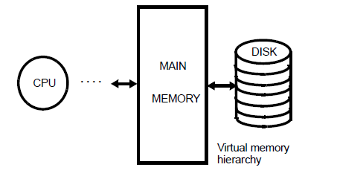
PAGED VIRTUAL MEMORY
VIRTUAL ADDRESS SPACE DIVIDED INTO PAGES
PHYSICAL ADDRESS SPACE DIVIDED INTO PAGEFRAMES
PAGE MISSING IN MM = PAGE FAULT
Pages not in MM are on disk: swap-in/swap-out
Or have never been allocated
New page may be placed anywhere in MM (fully associative map)
DYNAMIC ADDRESS TRANSLATION
Effective address is virtual
Must be translated to physical for every access
Virtual to physical translation through page table in MM

Slide 23
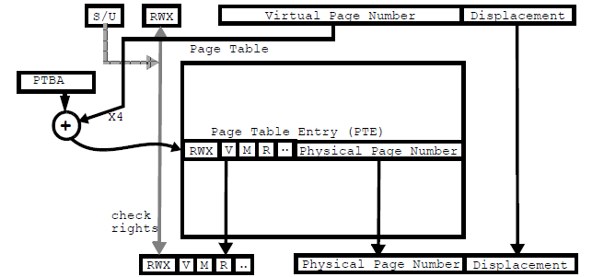
PAGE TABLE
PAGE TABLE TRANSLATES ADDRESS, ENFORCES PROTECTION
PAGE REPLACEMENT
FIFO—LRU--MFU
APPROXIMATE LRU (working set)
REFERENCE BIT (R) PER PAGE IS PERIODICALLY RESET BY O/S
PAGE CACHE: HARD vs SOFT PAGE FAULTS
WRITE STRATEGY IS WRITE BACK USING MODIFY (M) BIT
M AND R BITS ARE EASILY MAINTAINED BY SOFTWARE USINGTRAPS

Slide 24
HIERARCHICAL PAGE TABLE
HIERARCHICAL PAGE TABLE SUPPORTS SUPERPAGES (HOW?)
MULTIPLE DRAM ACCESSES PER MEMORY TRANSLATION
TRANSLATION ACCESSES CAN BE CACHED, BUT STILL REQUIRE MULTIPLE CACHE ACCESSES
SOLUTION: SPECIAL CACHE DEDICATED TO TRANSLATIONS

Slide 25
TRANSLATION LOOKASIDE BUFFER
PAGE TABLE ENTRY IS CACHED IN TLB
TLB IS ORGANIZED AS A CACHE (DM,SA,or FA) ACCESSED WITH THE VPN
PID ADDED TO DEAL WITH HOMONYMS
TLBs ARE MUCH SMALLER THAN CACHES BECAUSE OF COVERAGE
USUALLY TWO TLB: i-TLB AND d-TLB
TLB MISS CAN BE HANDLED IN A HARDWARED MMU OR BY A SOFTWARE TRAP HANDLER
“TABLE WALKING”

Slide 26
TYPICAL MEMORY HIERARCHY
CACHE SIZE LIMITED TO 1 PAGE PER WAY OF ASSOCIATIVITY

Slide 27
INDEXING CACHE WITH VIRTUAL ADDRESS BITS
WHEN THE L1 CACHE SIZE IS LARGER THAN 1 PAGE PER WAY OF ASSOCIATIVITY, THEN THE BLOCK MIGHT END UP IN TWO DIFFERENT SETS
THIS IS DUE TO SYNONYMS A.K.A. ALIASES

Slide 28
ALIASING PROBLEM
If the cache is indexed with the 2 extra bits of VA, then, a block may end up in different sets if accessed with two synonyms, causing consistency problems. How to avoid this??
On a miss, search all the possible sets (in this case 4 sets), move block if needed (SHORT miss), and settle on a (LONG) miss only if all 4 sets miss, OR
Since SLC is physically addressed and inclusion is enforced, make sure that SLC entry contains a pointer to the latest block copy in cache, OR
Page coloring: make sure that all aliases have the same two extra bits(z1=y1=x1 and z2=y2=x2)
No two synonyms can reside in the same page
Aliasing problem is more acute in caches that are both indexed and tagged with virtual address bits.

Slide 29
VIRTUAL ADDRESS CACHES
Index and tag are virtual and TLB is accessed on cache misses only
To search all the sets, we need to check each tag one by one in the TLB (very inefficient unless L1 cache is direct mapped)
Aliasing can be solved with anti-aliasing hardware, usually in the form of a reverse map in the SLC or some other table
Protection: Access right bits must be migrated to the L1 cache and managed
In multiprocessor systems virtual address caches aggravate the coherence problem
The main advantages of VA in L1 caches are 1) fast hit with large cache (no TLB translation in the critical path) and 2) very large TLB with extremely low miss rates

